Slide 1
Title – Banglore house price prediction.
By
Pranit Pisal

Slide 2
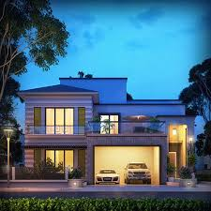
Objective
To predict the prices of Banglore area houses according to the requirements.

Slide 3

Solution
Doing EDA on current dataset.
Using Ridge model over the current data.
Analysing the insights and Graph patterns.
Finding out the right patterns.
Checking the values on which the price of the houses depends upon.
Choosing the efficient AI model.

Slide 4

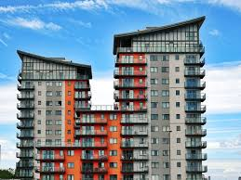
Business Impact
The solution provides help predicting the price of Banglore houses which are yet to be added in the dataset and customers can select the houses according to their requirements.

